Slide 1


Managing your source code with git
Louis-Emmanuel Martinet
lemart@bu.edu

Slide 2
What is version control? Why should I care?
Basic idea: track changes to a file or set of files over time so that you can recall specific versions later (+ more advanced tools)
Bad idea #1: quick and dumb
my_awesome_function_v1.m
my_awesome_function_v2.m
my_awesome_function_v3.m
Why?
After a few days/weeks, your project is a mess
What did you change between v1 and v3?
Really hard to collaborate with other people

Slide 3
What is version control? Why should I care?
Bad idea #2: using only dropbox (better but still very limited)
Why?
Doesn’t save all the versions (or save versions that you don’t really want to save)
What did you change between versions?
No advanced tools (very limited collaboration)

Slide 4
What is version control? Why should I care?
Your only hope: + (in fact, there are other tools but these 2 are the most popular ones)
software
website

Slide 5
How does it work?
Git
Manages a database (aka a repository) inside your code folder that stores changes made to your files (commit)
You can go back in time to see previous versions and which lines changed (log, diff)
You can develop in parallel several versions of a function while avoiding creating file_versionA.m file_versionB.m (branch)
You can collaborate efficiently! For example, easy to combine changes done to the same file by different people (merge)
And much more!

Slide 6
How does it work?
Github.com
Serves as a central repository to store your code
At least one online backup of our code
Nice visual interface to navigate your code and its history
Easily invite people to download your code and collaborate
And much more!

Slide 7
Ok, that’s awesome, you convinced me.
That’s it for the general intro, let’s use git+github!

Slide 8
Step 0: setup
Create an account on github.com if you don’t have one (with your BU email so you can have free private repositories)
Download and install git on your computer (google ‘git download’)
Configure git on your computer (name and email) git config --global user.name "Your Name” git config --global user.email "your_email@whatever.com"

Slide 9
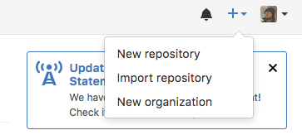
Step 1: start a new project on github.com

Slide 10
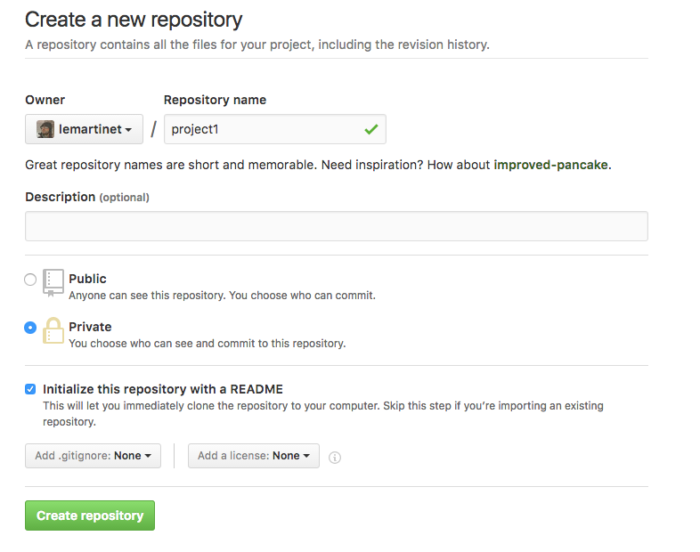
Step 1: start a new project on github.com

Slide 11
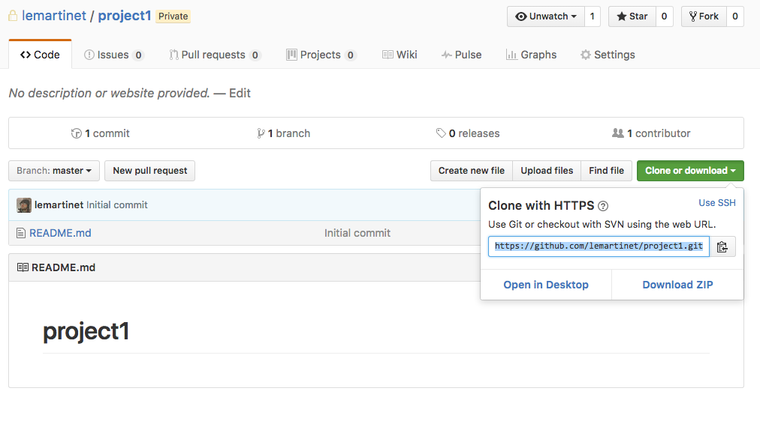
Step 1: start a new project on github.com

Slide 12
Step 1: start a new project on github.com
In your terminal cd your_code_folder git clone https://github.com/USERNAME/PROJECTNAME.git
Creates a folder PROJECTNAME with the repository files inside (here, only README.md)
Run cd PROJECTNAME ls -a
The folder .git contains all the information about your code history

Slide 13
Step 1: start a new project on github.com
Note: you can also start an empty local repository on your computer without github using: mkdir myproject cd myproject git init

Slide 14
Step 2: add a file to the repository
Create a new file inside the project folder, for example file1.m touch file1.m
Check the status of the repository git status
On branch master
Your branch is up-to-date with 'origin/master'.
Untracked files:
(use "git add <file>..." to include in what will be committed)
file1.m
nothing added to commit but untracked files present (use "git add" to track)

Slide 15
Step 2: add a file to the repository
git add file1.m git status
On branch master
Your branch is up-to-date with 'origin/master'.
Changes to be committed:
(use "git reset HEAD <file>..." to unstage)
new file: file1.m
Note: you can add multiple files using for example git add *.m

Slide 16
Step 3: Store the changes locally
Ask git to store the changes in the database git commit -m "New file added"
Look at the history of the code git log

Slide 17
Step 3: Store the changes locally
Identifier (hash)
commit 2f77391614c61be5f3dc74a67131c3ca13e91242
Author: Louis-Emmanuel Martinet <louis.emmanuel.martinet@gmail.com>
Date: Tue Oct 18 01:26:40 2016 -0400
New file added
commit 1d13264d6d21fb3f8f81af121c893603b6fc1198
Author: lemartinet <lemartinet@users.noreply.github.com>
Date: Tue Oct 18 00:59:31 2016 -0400
Initial commit

Slide 18
Step 4: Send the changes to github
git status
On branch master
Your branch is ahead of 'origin/master' by 1 commit.
(use "git push" to publish your local commits)
nothing to commit, working directory clean
git push
Check your repository on github.com
When you work with other people, you need to run git pull before you push to get the last code updates (more later)

Slide 19
Step 5: edit file1, commit and push
Add something within file1.m, e.g.: function out = file1(in) out = in; end
What does git think about it? git status
On branch master
Your branch is up-to-date with 'origin/master'.
Changes not staged for commit:
(use "git add <file>..." to update what will be committed)
(use "git checkout -- <file>..." to discard changes in working directory)
modified: file1.m
no changes added to commit (use "git add" and/or "git commit -a")

Slide 20
Step 5: edit file1.m, commit and push
Ask git to store those edits
With two commands git add file1.m git commit -m "Added some code"
Using only one command git commit -am "Added some code"

Slide 21
Step 6: more edits, difference between versions
Edit file1.m, for example change line 2: out = in + 1;
Ask git to show the difference with the last committed version git diff
diff --git a/file1.m b/file1.m
index 94c4e4a..d1f9ba0 100644
--- a/file1.m
+++ b/file1.m
@@ -1,4 +1,4 @@
function out = file1(in)
-out = in;
+out = in + 1;
end
Note: you can compare any commits using their identifiers (found in the log), e.g.: git diff 1d13 9da5

Slide 22
Step 7: cancel the edits
Try git checkout -- file1.m
File1.m is back to its previous state stored in the last commit

Slide 23
Step 8: creating a new branch
What is a branch?
You can picture your code in git as a tree
It starts from the trunk called the master branch
From there you can create a different version of the code in a different branch
(commits)
Master C1 → C2 → C3
versionA C4 → C5
→

Slide 24
Step 8: creating a new branch
Create a new branch in git git branch versionA git branch
Work in the new branch (i.e. HEAD points to versionA) git checkout versionA
Make some edits (change line 2 again for example)
Commit the changes git commit -am 'Edited file1'
Return back to the master branch git checkout master
What happened to file1.m?
During the checkout, git replaced file1.m with the last version stored in master!
Compare master and versionA git diff versionA

Slide 25
Step 9: Merging branches
When you’re happy with your code developed in another branch, you can merge it in the main branch, aka master git checkout master git merge versionA
(you can check that master and versionA are identical using git diff versionA)
Master C1 → C2 → C3 → C4 → C5
versionA C4 → C5
You can delete the branch versionA now, since its changes are part of master git branch -d versionA
Master C1 → C2 → C3 → C4 → C5
→

Slide 26
Step 10: dealing with conflicts while merging
If you make changes to the same line of a given file in two different branches and try to merge them, you’ll get a conflict
That can happen also when you work with other people on the same repository and make edits to the same file that are not compatible
You need to select the part of the code you want to keep

Slide 27
Step 10: dealing with conflicts while merging
Quick exercise: try to generate a conflict and then solve it
Create a new branch from master called versionB
Edits file1.m in that branch (make sure you checkout first to versionB) and commit the changes
Checkout back to master, edit file1.m at the same line you changed in versionB but using a different code and commit
Now try to merge versionB
Auto-merging file1.m
CONFLICT (content): Merge conflict in file1.m
Automatic merge failed; fix conflicts and then commit the result.

Slide 28
Step 10: dealing with conflicts while merging
Quick exercise: try to generate a conflict and then solve it
Open file1.m, what do you see?
function out = file1(in)
<<<<<<< HEAD
out = in + 2;
=======
out = in + 3;
>>>>>>> versionA
End
You need to edit the code to keep only what you want, and then commit: the conflict is solved!

Slide 29
Step 10: dealing with conflicts while merging
Quick exercise #2: try to simulate a conflict between two people
Clone your github repository into 2 different folders
Edit the same line of the same file in each local repository and commit
Try to push both of them to github
What happens?
CONFLICT
What to do?
You need to pull first to download the conflicting update, merge it and then push again. Try it!

Slide 30
Other useful commands (1/2)
To delete a file from the repository, two options
Delete both from git and from your computer (the file still exists in previous commits) git rm FILE
Delete only from git (i.e. the file is not tracked anymore) git rm --cached FILE
To move/rename files within the repository while keeping their history git mv FILE1 FILE2
Create a .gitignore file containing file names, folder names or type of file to be ignored by git (one by line): for example file_to_ignore.txt folder_to_ignore/ *.m~

Slide 31
Other useful commands (1/2)
You can give a name to your last commit using a tag git tag NAME or to any commits using their identifier git tag NAME IDENTIFIER Examples of use: tag the commit that you used to produce some results for a conference, tag releases of a software you develop (v1.0, v1.1, v1.2)
If you realize you made a mistake in your code just after committing, you can edit your file and amend your commit as if it was right the first time: git commit --amend -m 'Message’ (it won’t work if you’ve already pushed to github)
When you push to github, only the master branch is sent. If you want to also send a particular branch to github, use: git push -u origin BRANCH (works also for tags)

Slide 32
Final comments (1/2)
Recommended to have one repository by project, not a huge repository with all the code you’ve ever created.
Write meaningful comments for commits, your future you will be thankful
Don’t commit your code every 2 months! Try to commit as soon as you have a significant addition
It is possible to have a git repository inside your dropbox
Provides another backup
Gives you access to your last version of your files on another computer if you forgot to commit/push to github

Slide 33
Final comments (2/2)
Some GUI are available (from github or other ones)
The most recent versions of Matlab integrate well with git
Git and github are made for source code (i.e. text files) but you can also add binary files like an image file from a figure or a matlab .mat file. However, it is not optimized for that and space is limited on github.com
If you want to collaborate but are not invited to a github repository, you can fork it and then send a pull request (more advanced topic, see resources).

Slide 34
More resources
Many, many resources on the internet
Github cheat sheet to print
https://services.github.com/kit/downloads/github-git-cheat-sheet.pdf
Fun tutorial
https://try.github.io/levels/1/challenges/1
Play with branching to better understand
http://learngitbranching.js.org/
FAQ on stackoverflow
http://stackoverflow.com/questions/315911/git-for-beginners-the-definitive-practical-guide
More advanced tutorials, for example
https://www.atlassian.com/git/tutorials/advanced-overview/
http://gitimmersion.com/

